Slide 1
STATPLAY INSIGHTS
TEAM 0507_03
07 December 2023

Slide 2
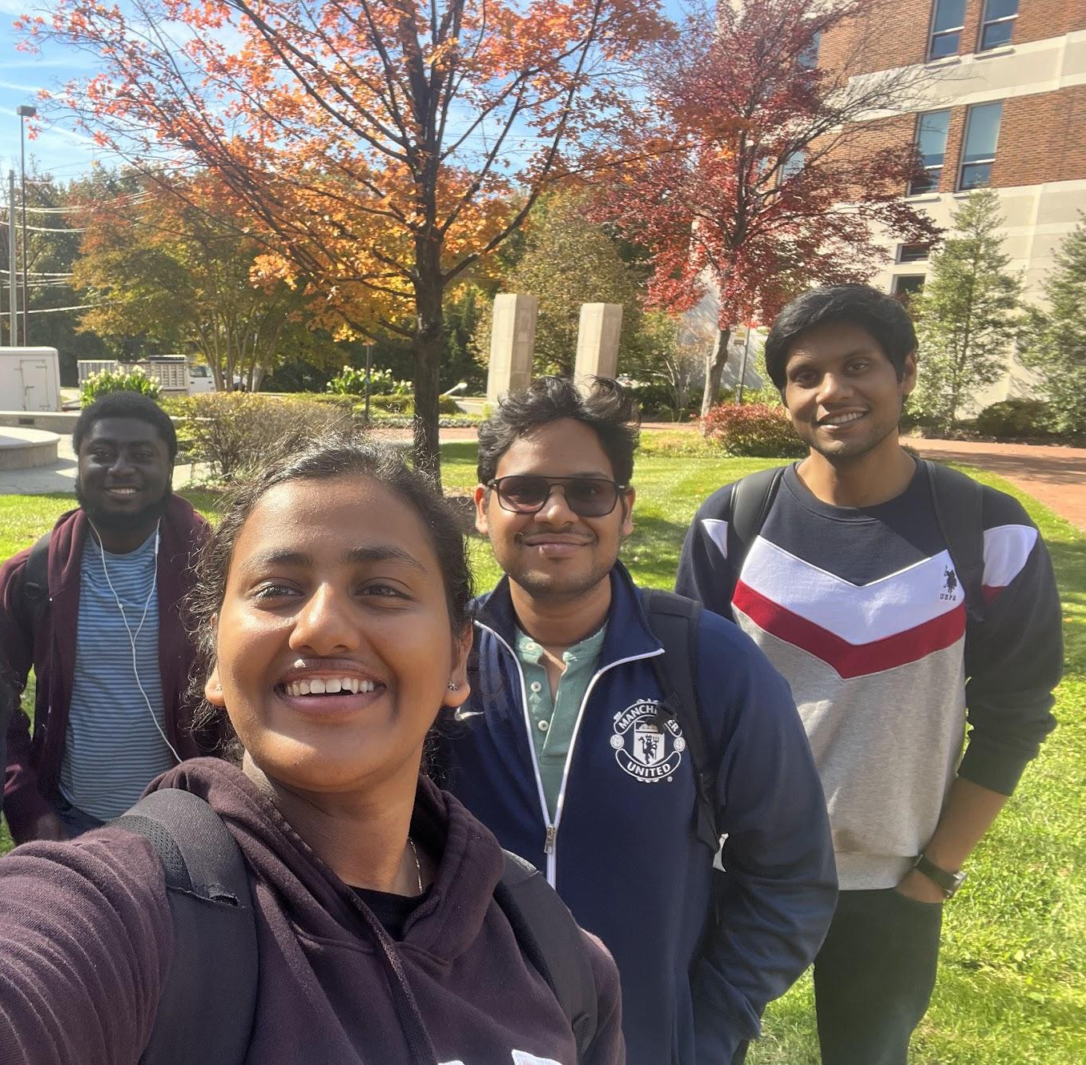
THE TEAM

Slide 3
THE TEAM
Sahil Gupta
David Dapaah
>
>
Athul Ramachandran
>
>
Linta Joly

Slide 4

OUR CLIENT

Slide 5
OUR CLIENT
The National Endowment for the Arts is an independent federal agency that funds and promotes the creative capacity of communities by providing diverse opportunities for arts participation in US.
They are planning to promote a group of highly talented high school music performers in Maryland, who will be performing in the Women’s Softball games, in support the University of Maryland – College Park’s Team.

Slide 6

OUR CLIENT
National Endowment for the Arts consulted us to analyze the previous years University of Maryland Women's Softball Team’s performance and help the group of performers identify the matches they have to perform to get a good recognition in the start for their career in the world of arts.

Slide 7
MISSION OBJECTIVE
To research Maryland team’s performance against opponent teams from 1995 to 2023.
Explore the team's winning percentages in both home and away games.
Analyze the team’s performance in various seasons.
Compare home versus away game team winning percentages and quantify potential home field advantage
By focusing on long-term and short-term performance metrics, we can advise games to our performers in which University of Maryland’s team have a competitive advantage.

Slide 8
HOW WE ACHIEVED
22%
68%
Neptune is the farthest planet from the Sun
Jupiter is the biggest planet of them all
Data Collection
Database
Design
Business
Transactions
Data Visualisation
Mercury is the closest planet to the Sun
Despite being red, Mars is a cold place

Slide 9
DATA COLLECTION
Mercury is the closest planet to the Sun
Despite being red, Mars is a cold place

Slide 10
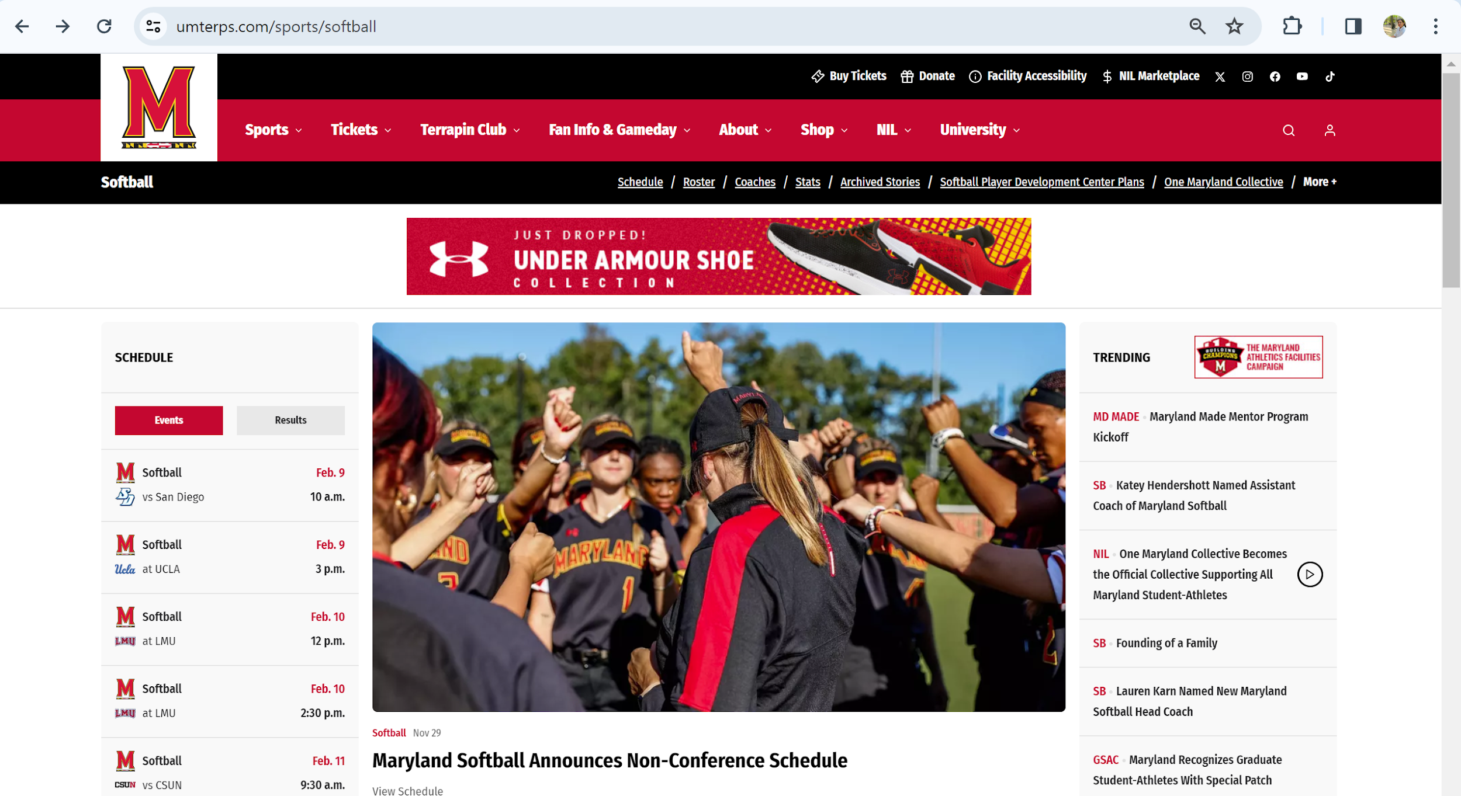
DATA COLLECTION
Mercury is the closest planet to the Sun
Despite being red, Mars is a cold place

Slide 11
DATABASE DESIGN
Mercury is the closest planet to the Sun
Despite being red, Mars is a cold place

Slide 12
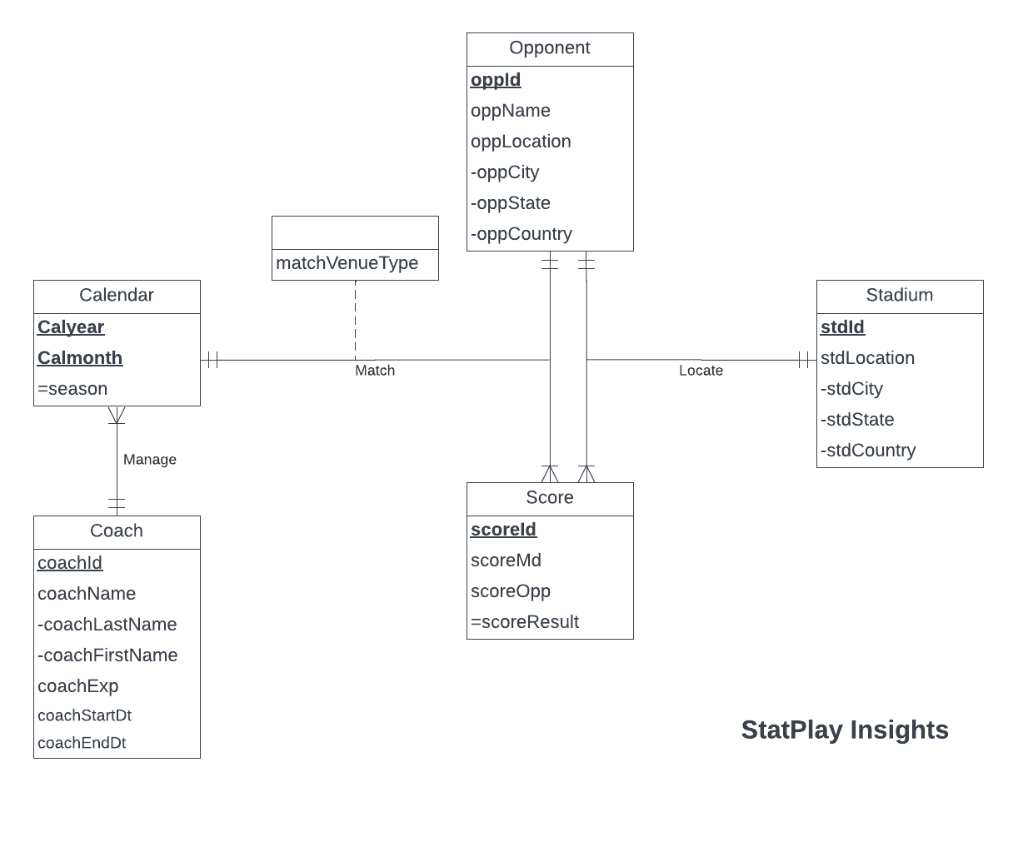
CONCEPTUAL DATABASE DESIGN
Despite being red, Mars is a cold place

Slide 13
LOGICAL DATABASE DESIGN
- Opponent (oppId, oppName, oppCity, oppState,oppCountry)
- Score(scoreId, scoreMd, scoreOpp)
- Stadium(stdId, stdCity, stdState,stdCountry)
- Coach (coachId, coachFirstName, coachLastName, coachExp, coachStartDt, coachEndDt)
- Calendar(calYear, calmonth, coachId)
- Match (scoreId, calYear, calMonth,oppId, matchVenueType)
- Locate (scoreId, oppId,stdId)
Data Collection
Mercury is the closest planet to the Sun
Despite being red, Mars is a cold place

Slide 14
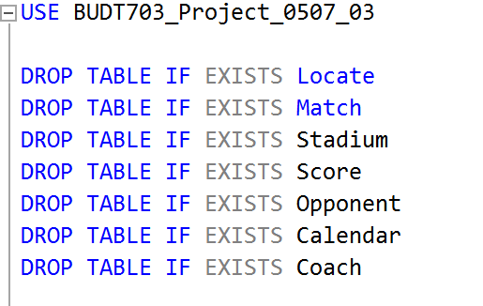
PHYSICAL DATABASE DESIGN
Data Collection
Use Database and Drop
Existing tables if any:
Mercury is the closest planet to the Sun
Despite being red, Mars is a cold place

Slide 15
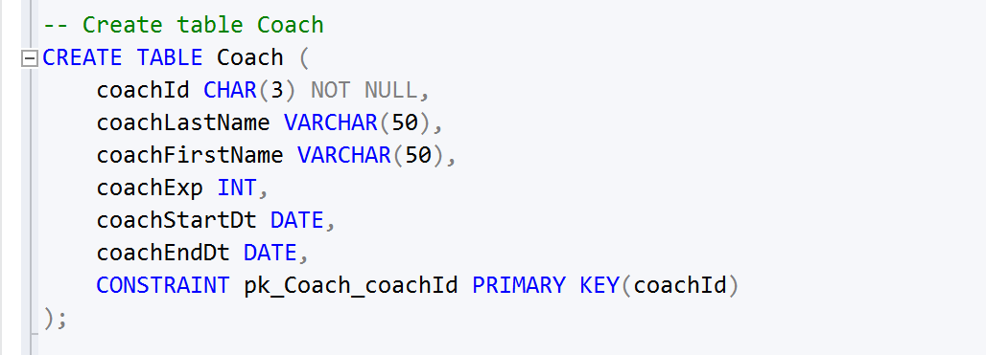
PHYSICAL DATABASE DESIGN
- Coach (coachId, coachFirstName, coachLastName, coachExp, coachStartDt,coachEndDt)
Data Collection
Database Creation for
Coach :
Mercury is the closest planet to the Sun
Despite being red, Mars is a cold place

Slide 16
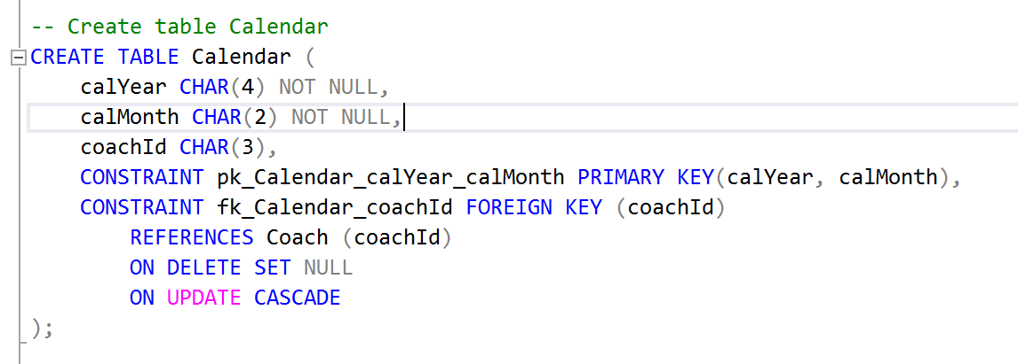
PHYSICAL DATABASE DESIGN
- Calendar(calYear, calmonth, coachId)
Data Collection
Database Creation for
Calendar :
Mercury is the closest planet to the Sun
Despite being red, Mars is a cold place

Slide 17
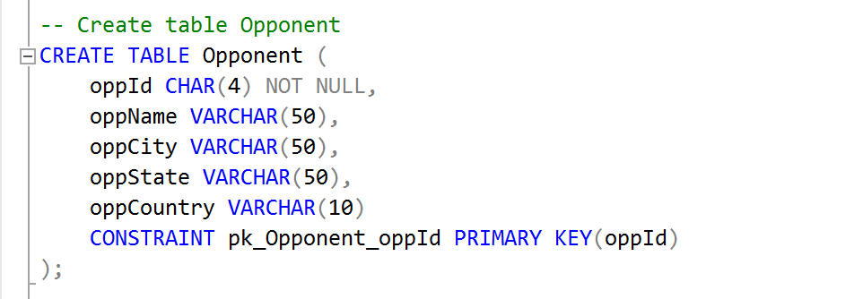
PHYSICAL DATABASE DESIGN
- Opponent (oppId, oppName, oppCity, oppState,oppCountry)
Data Collection
Database Creation for
Opponent :
Mercury is the closest planet to the Sun
Despite being red, Mars is a cold place

Slide 18
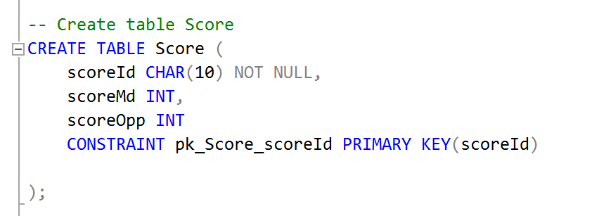
PHYSICAL DATABASE DESIGN
- Score(scoreId, scoreMd, scoreOpp)
Data Collection
Database Creation for
Score :
Mercury is the closest planet to the Sun
Despite being red, Mars is a cold place

Slide 19
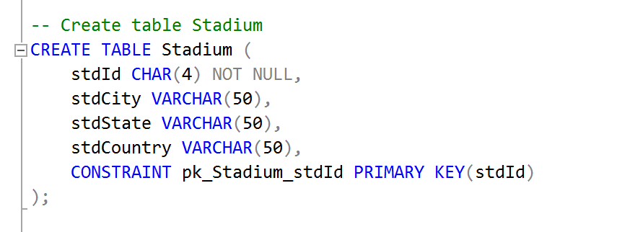
PHYSICAL DATABASE DESIGN
- Stadium(stdId, stdCity, stdState,stdCountry)
Data Collection
Database Creation for
Stadium :
Mercury is the closest planet to the Sun
Despite being red, Mars is a cold place

Slide 20
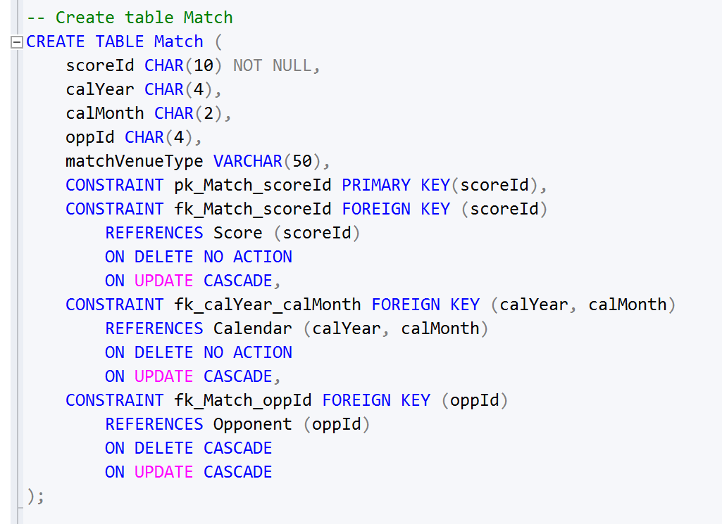
PHYSICAL DATABASE DESIGN
- Match (scoreId, calYear, calMonth,oppId, matchVenueType)
Data Collection
Database Creation for
Match :
Mercury is the closest planet to the Sun
Despite being red, Mars is a cold place

Slide 21
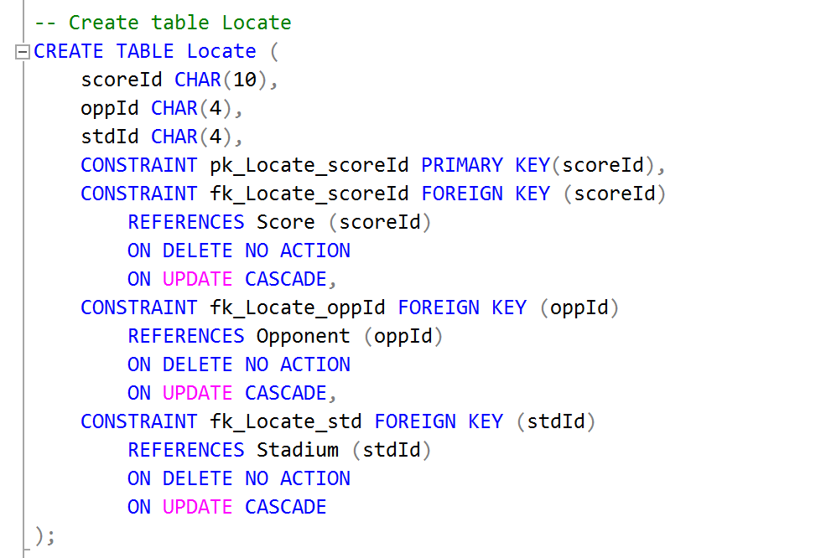
PHYSICAL DATABASE DESIGN
- Locate (scoreId, oppId,stdId)
Data Collection
Database Creation for
Locate :
Mercury is the closest planet to the Sun
Despite being red, Mars is a cold place

Slide 22
BUSINESS TRANSACTIONS
Data Collection
Mercury is the closest planet to the Sun
Despite being red, Mars is a cold place

Slide 23
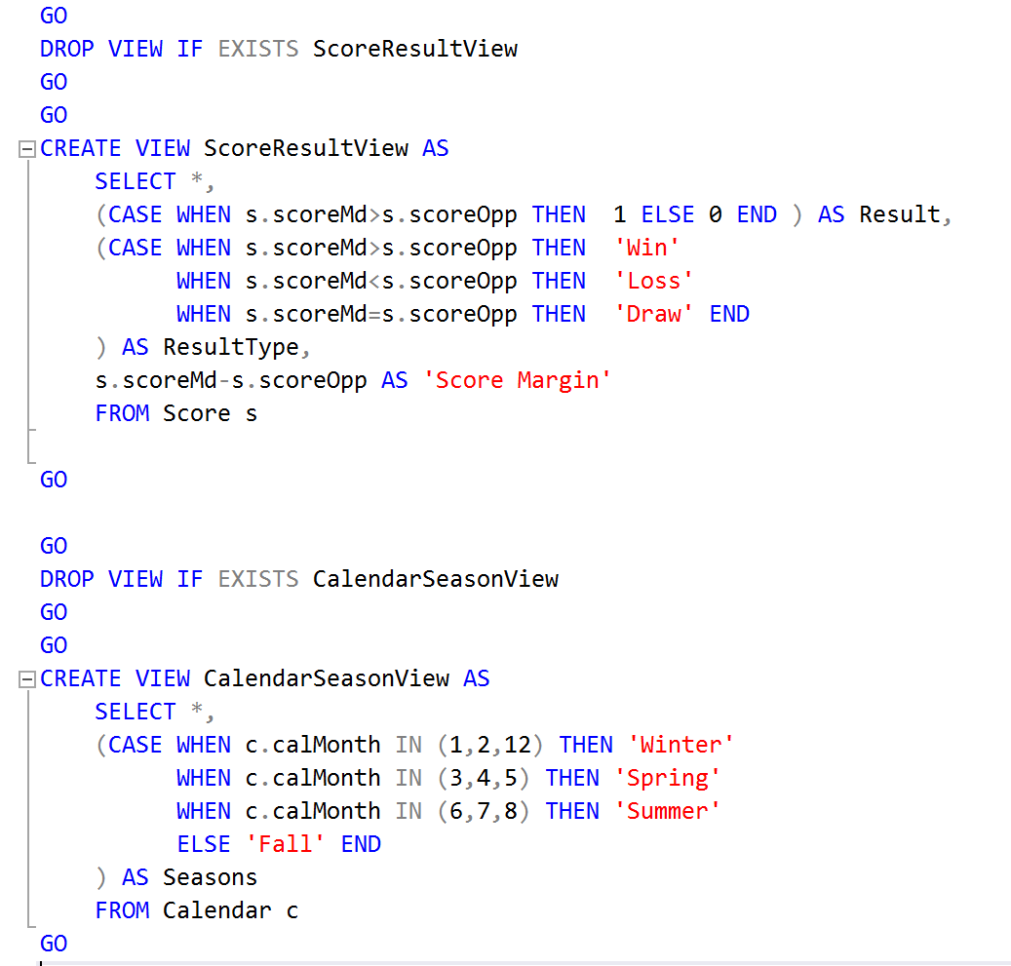
CREATING VIEWS
Mercury is the closest planet to the Sun
Despite being red, Mars is a cold place

Slide 24
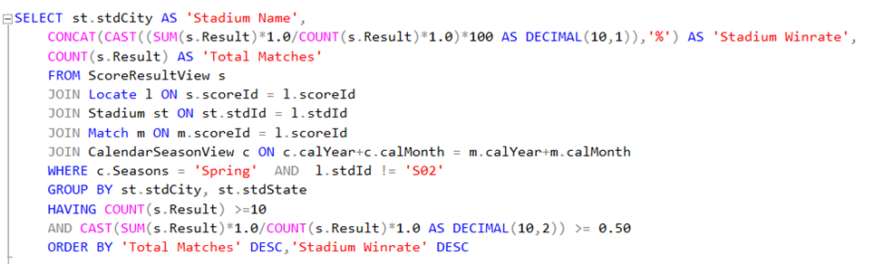
BUSINESS TRANSACTIONS
Which stadiums does Maryland team gave the best winrate against at the away games in Spring Season?
The performers preferred to perform in the Spring.
Mercury is the closest planet to the Sun
Despite being red, Mars is a cold place

Slide 25
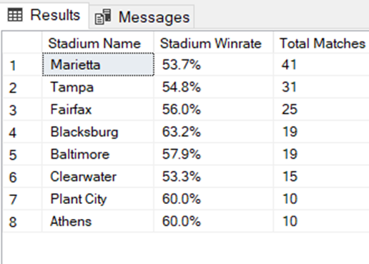
Which teams does Maryland team gave the best win rate against at the home games?
Mercury is the closest planet to the Sun
Despite being red, Mars is a cold place

Slide 26
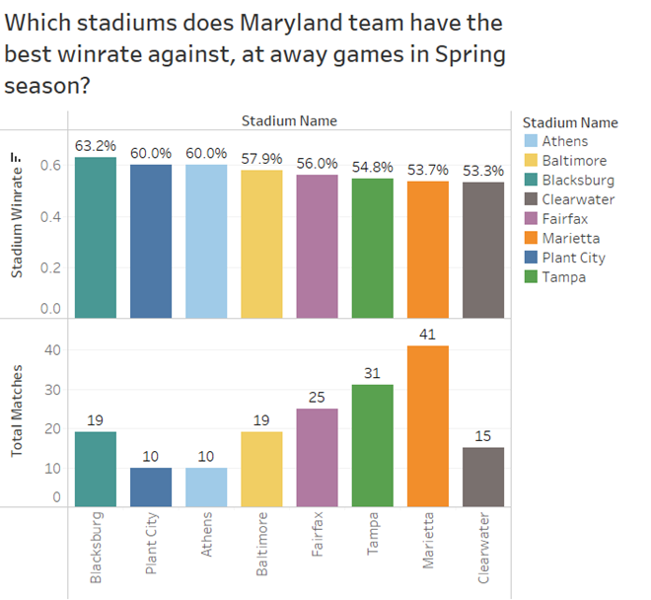
DATABASE VISUALISATION

Slide 27
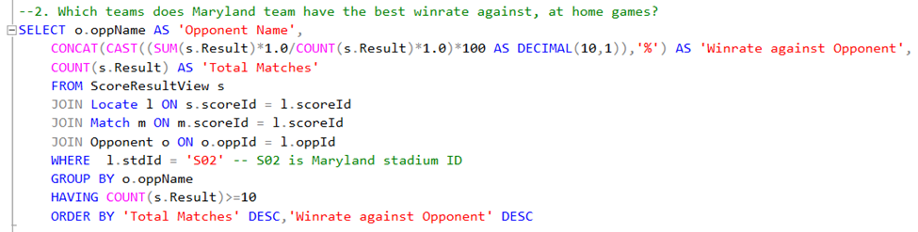
ANOTHER BUSINESS TRANSACTION -2
Which teams does Maryland team gave the best winrate against, at home games
Mercury is the closest planet to the Sun
Despite being red, Mars is a cold place

Slide 28
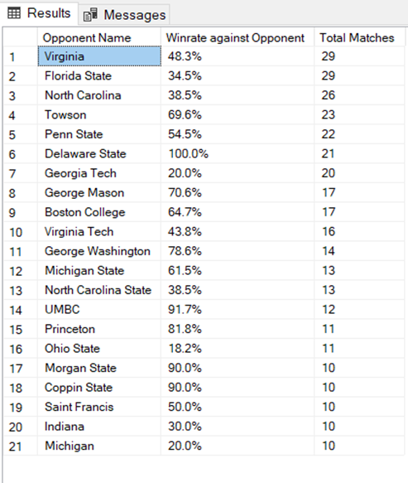
Which teams does Maryland team gave the best winrate against, at home games
Mercury is the closest planet to the Sun
Despite being red, Mars is a cold place

Slide 29
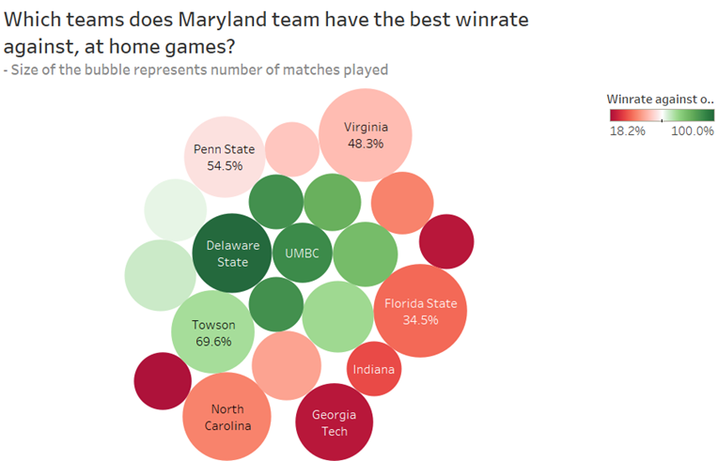

Slide 30
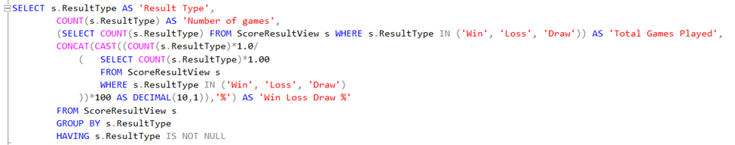
ANOTHER BUSINESS TRANSACTION - 3
What is the overall win/loss/draw rate
Mercury is the closest planet to the Sun
Despite being red, Mars is a cold place

Slide 31
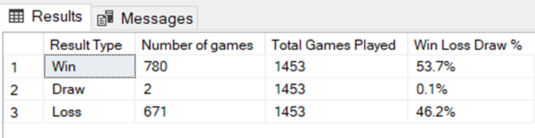
What is the overall win/loss/draw rate
Mercury is the closest planet to the Sun
Despite being red, Mars is a cold place

Slide 32
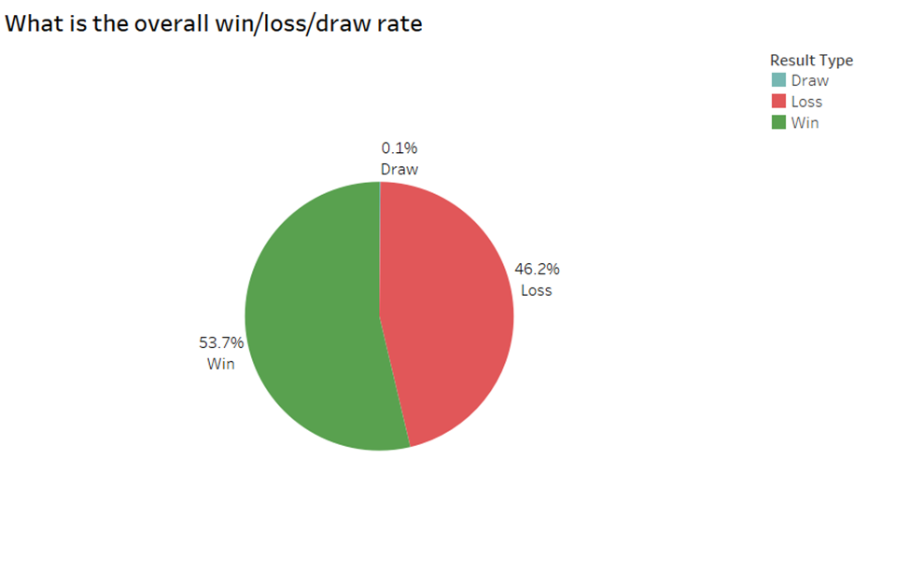

Slide 33
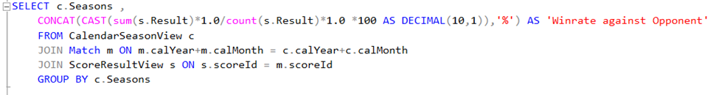
ANOTHER BUSINESS TRANSACTION - 4
What is the winrate in Spring and Winter
Mercury is the closest planet to the Sun
Despite being red, Mars is a cold place

Slide 34
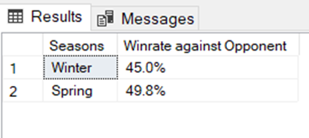
What is the winrate in Spring and Winter
Mercury is the closest planet to the Sun
Despite being red, Mars is a cold place

Slide 35
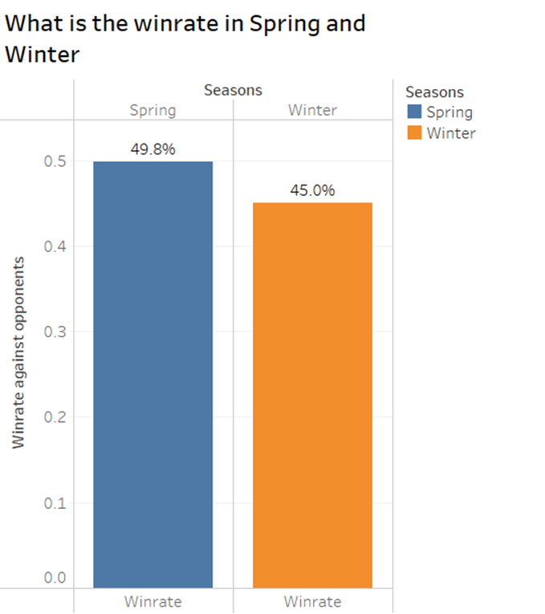

Slide 36
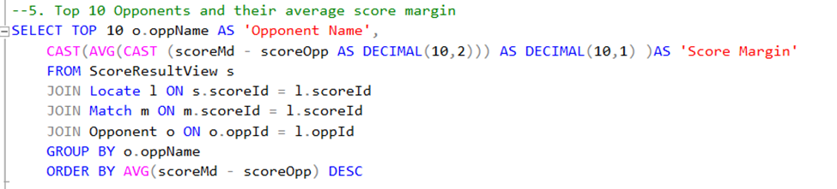
ANOTHER BUSINESS TRANSACTION - 5
What is the average score margin of Top 10 opponents
Mercury is the closest planet to the Sun
Despite being red, Mars is a cold place

Slide 37
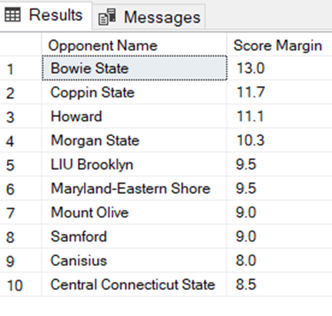
What is the average score margin of Top 10 opponents
Mercury is the closest planet to the Sun
Despite being red, Mars is a cold place

Slide 38
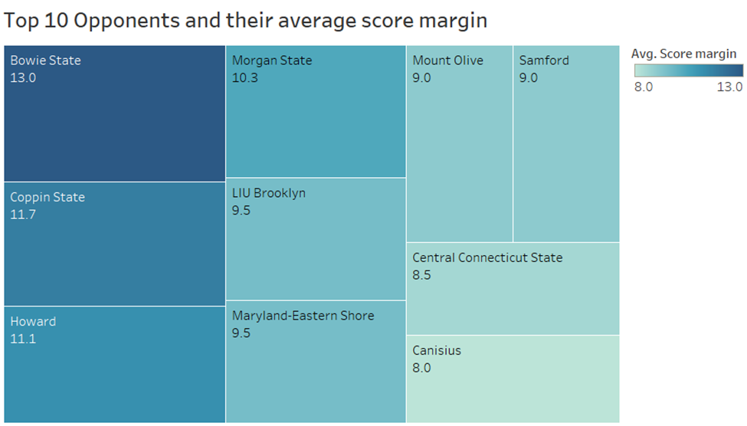

Slide 39
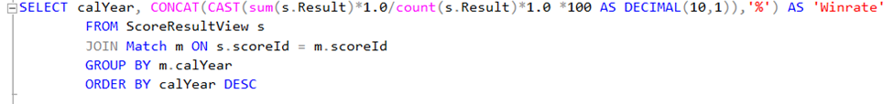
ANOTHER BUSINESS TRANSACTION - 6
What is the yearly trend for the Winrate?
Mercury is the closest planet to the Sun
Despite being red, Mars is a cold place

Slide 40
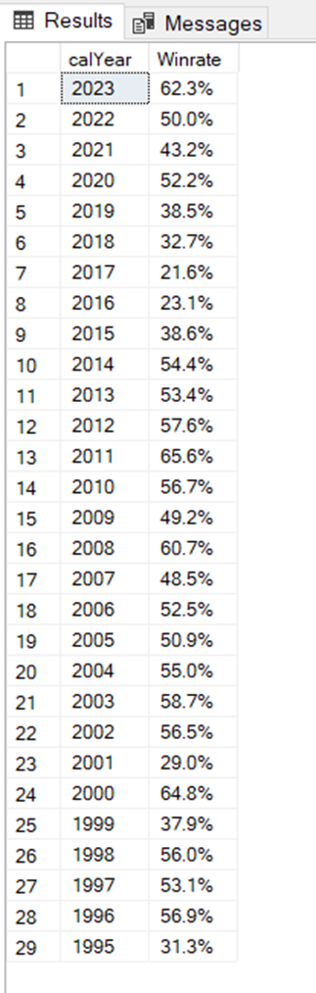
What is the yearly trend for the Winrate?
Mercury is the closest planet to the Sun
Despite being red, Mars is a cold place

Slide 41
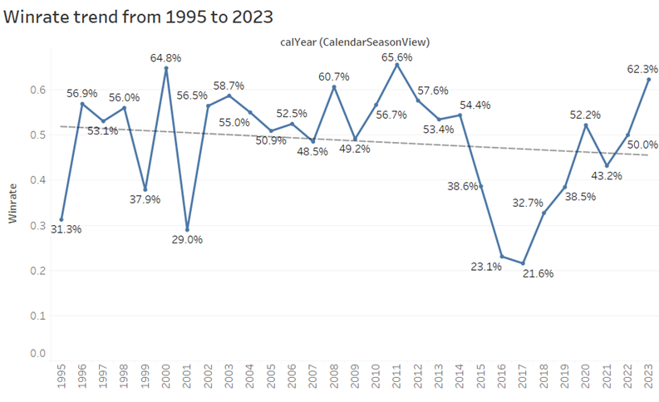

Slide 42
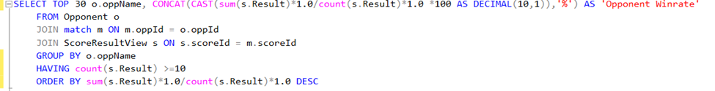
ANOTHER BUSINESS TRANSACTION - 7
What is Maryland team’s performance against each opponent, consider Top 30 opponent winrates?
Mercury is the closest planet to the Sun
Despite being red, Mars is a cold place

Slide 43
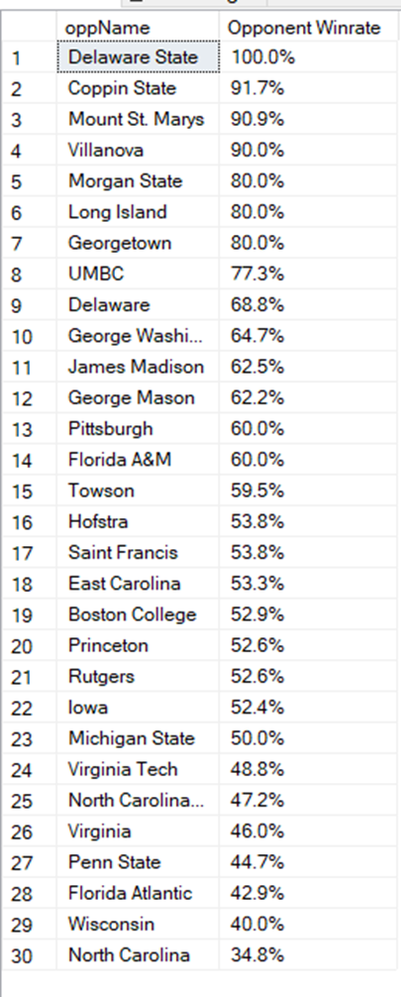
What is Maryland team’s performance against each opponent, consider Top 30 opponent winrates?
Mercury is the closest planet to the Sun
Despite being red, Mars is a cold place

Slide 44
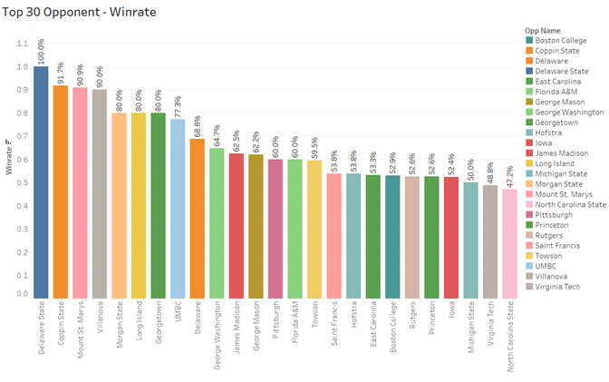

Slide 45
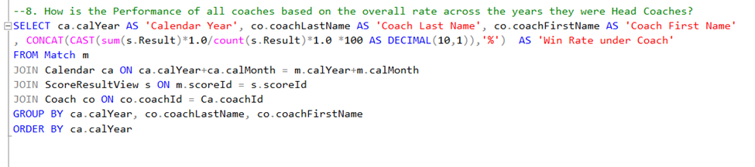
ANOTHER BUSINESS TRANSACTION - 8
How is the Performance of all coaches based on the overall rate across the years they were Head Coaches?
Mercury is the closest planet to the Sun
Despite being red, Mars is a cold place

Slide 46
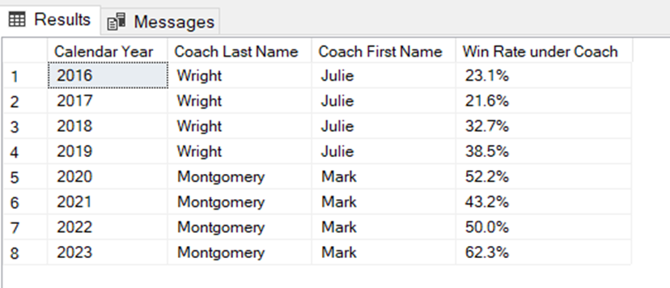
How is the Performance of all coaches based on the overall rate across the years they were Head Coaches?
Mercury is the closest planet to the Sun
Despite being red, Mars is a cold place

Slide 47
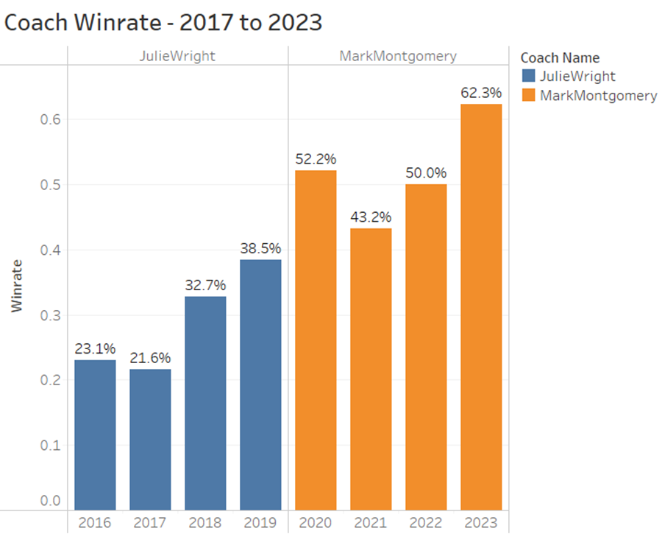

Slide 48
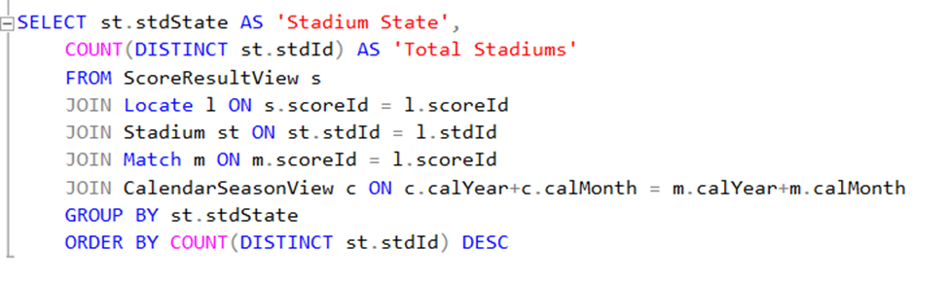
ANOTHER BUSINESS TRANSACTION - 9
Which are the states with the maximum number of games
Mercury is the closest planet to the Sun
Despite being red, Mars is a cold place

Slide 49
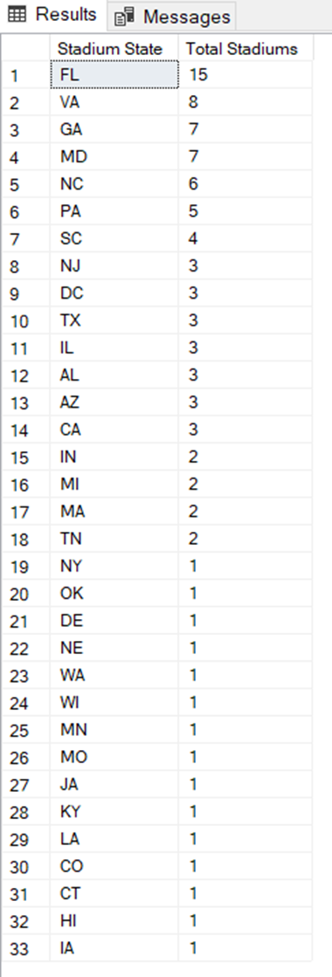
How is the Performance of all coaches based on the overall rate across the years they were Head Coaches?
Mercury is the closest planet to the Sun
Despite being red, Mars is a cold place

Slide 50
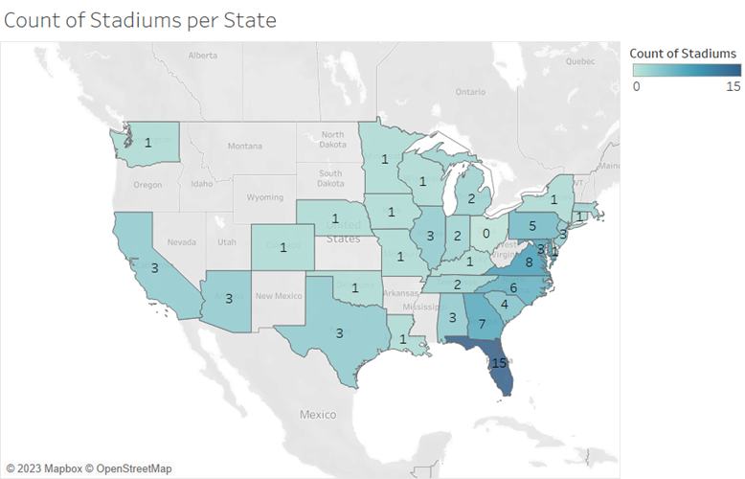

Slide 51
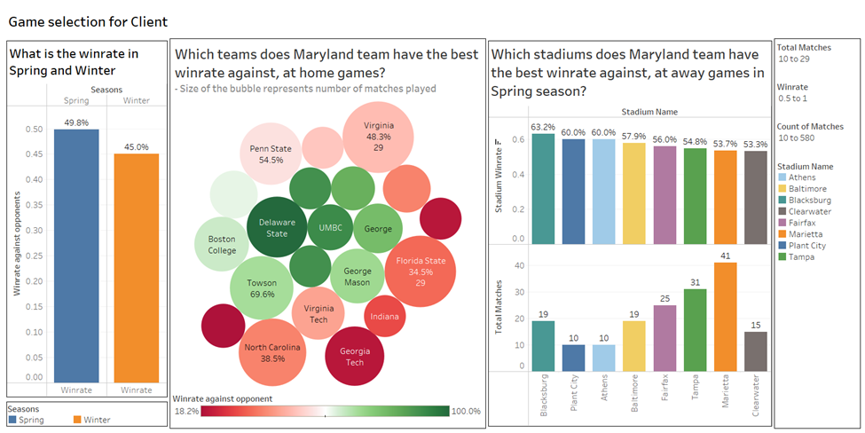
DASHBOARD FOR GAME SELECTION

Slide 52
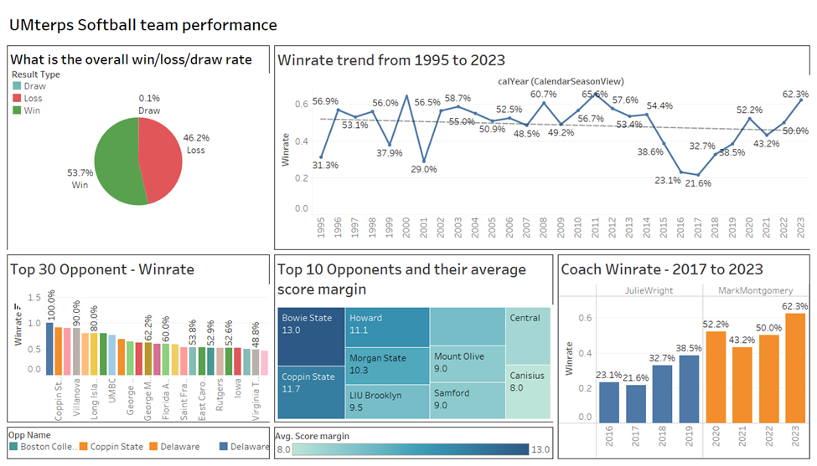
DASHBOARD FOR UMTERPS TEAM PERFORMANCE

Slide 53
INFERENCES
Based on our analysis, we were able to narrow down our selections from a total of 241 opponents and 100 stadiums:
We identified the top 5 Home games where Maryland's Softball team has a winning rate of more than 50%.
We identified the top 5 Away games where Maryland's Softball team has a winning rate of more than 50% in spring season.
Mercury is the closest planet to the Sun

Slide 54
POTENTIAL FUTURE INITIATIVES
- Incorporate Weather data to analyze the impact of temperature and humidity on team’s performance.
- Incorporate Distance of the stadium from Maryland and analyze the team’s performance in stadium’s close by.
- Study the demographics of the viewers of a match and analyze the best matches for the artists to perform.
Mercury is the closest planet to the Sun
Despite being red, Mars is a cold place

Slide 55
Questions?
Mercury is the closest planet to the Sun
Despite being red, Mars is a cold place

Slide 56
THANK YOU!
Mercury is the closest planet to the Sun
Despite being red, Mars is a cold place

